Slide 1

Studi kasus CRUD- Database

Slide 2
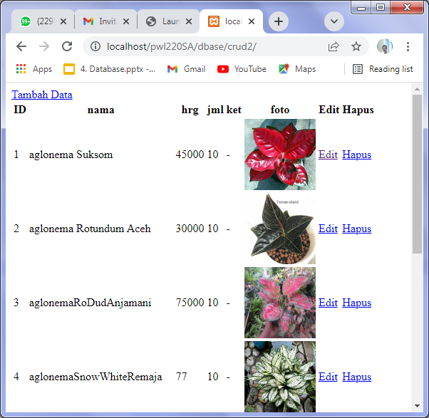
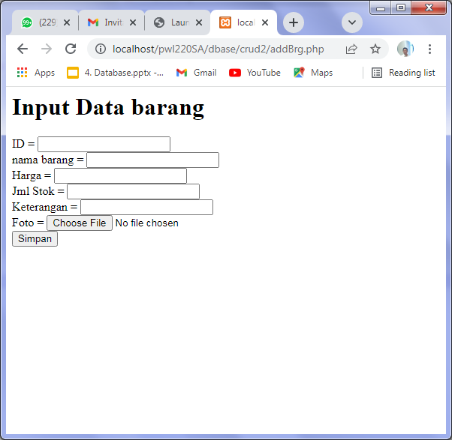
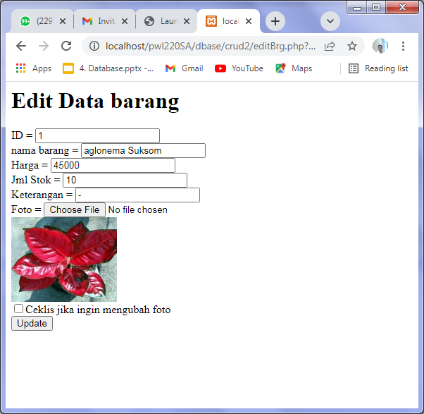
Proses CRUD,
Menambahkan data dari Form ke dalam Tabel di database
Menampilkan data dari tabel (database) ke halaman web
Melakukan proses Update data ( Update,Delete)

Slide 3
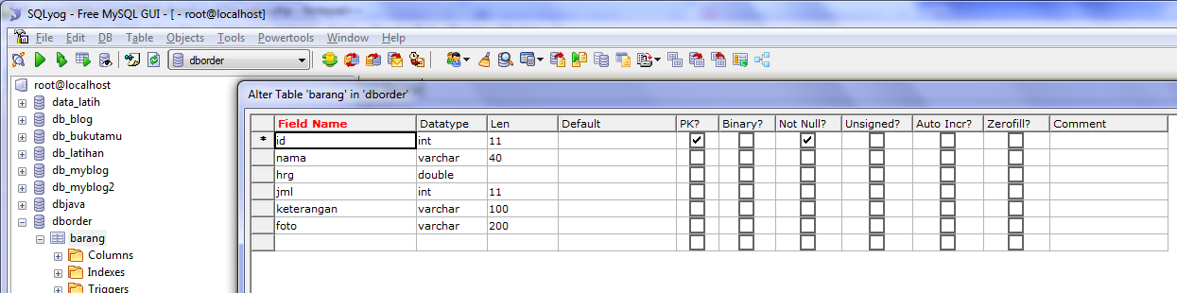
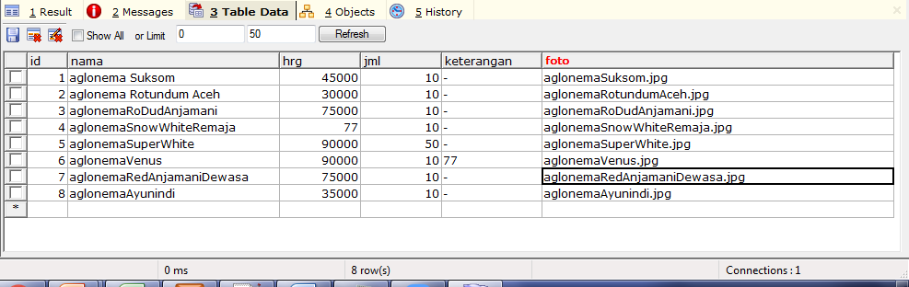

Slide 4
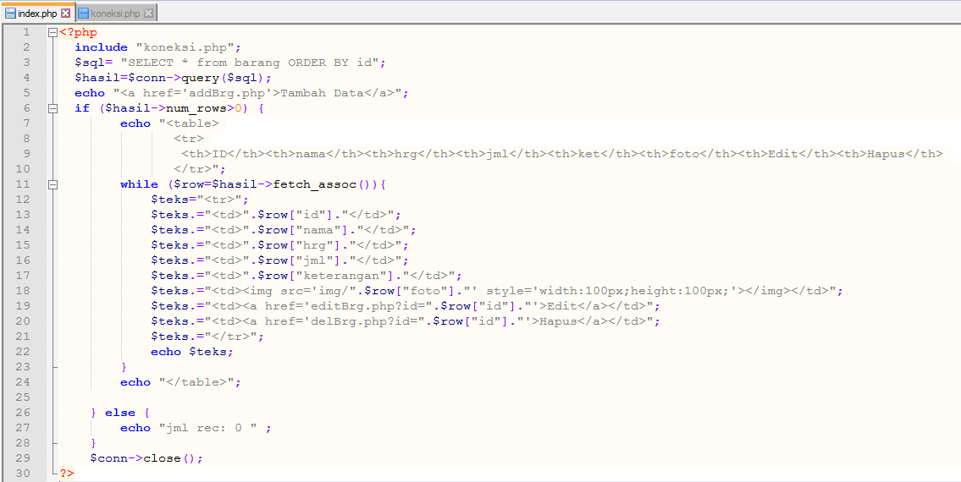
//koneksi.php
<?php
$servername = "localhost";
$username = "root";
$password = "";
$myDB="dbOrder";
$conn = new mysqli($servername, $username, $password,$myDB);
if ($conn->connect_error)
die("Connection failed: " . $conn->connect_error);
//echo "Connected to DataBase successfully";
?>
Index.php

Slide 5
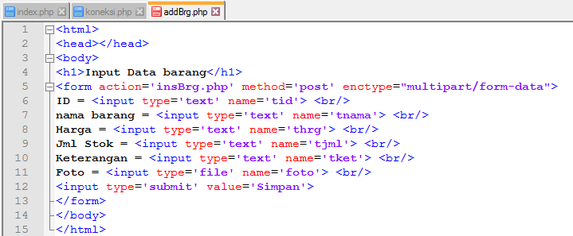
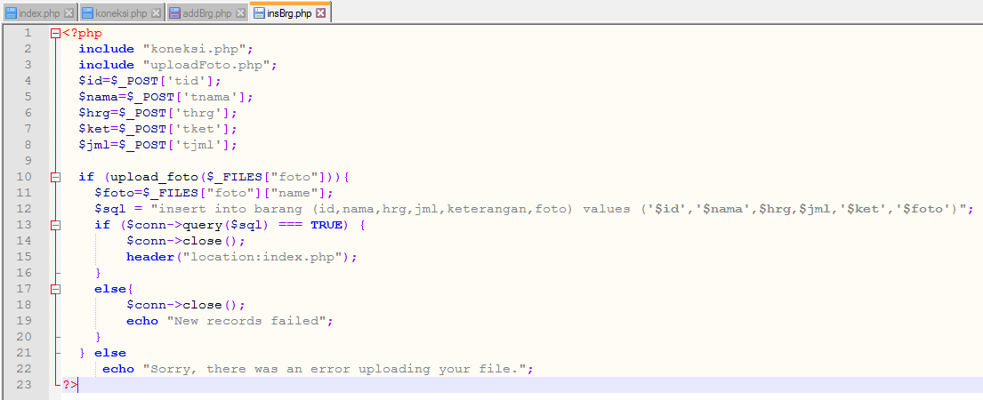
addBrg.php
insBrg.php

Slide 6
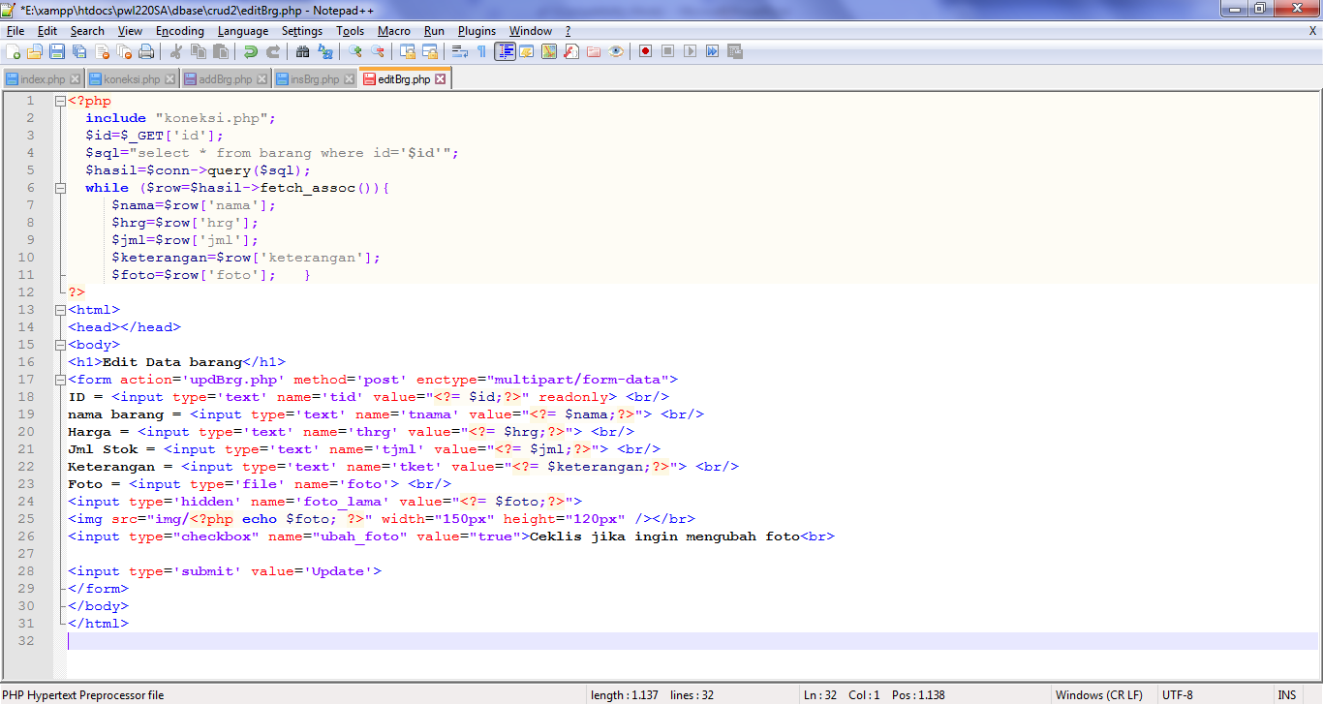
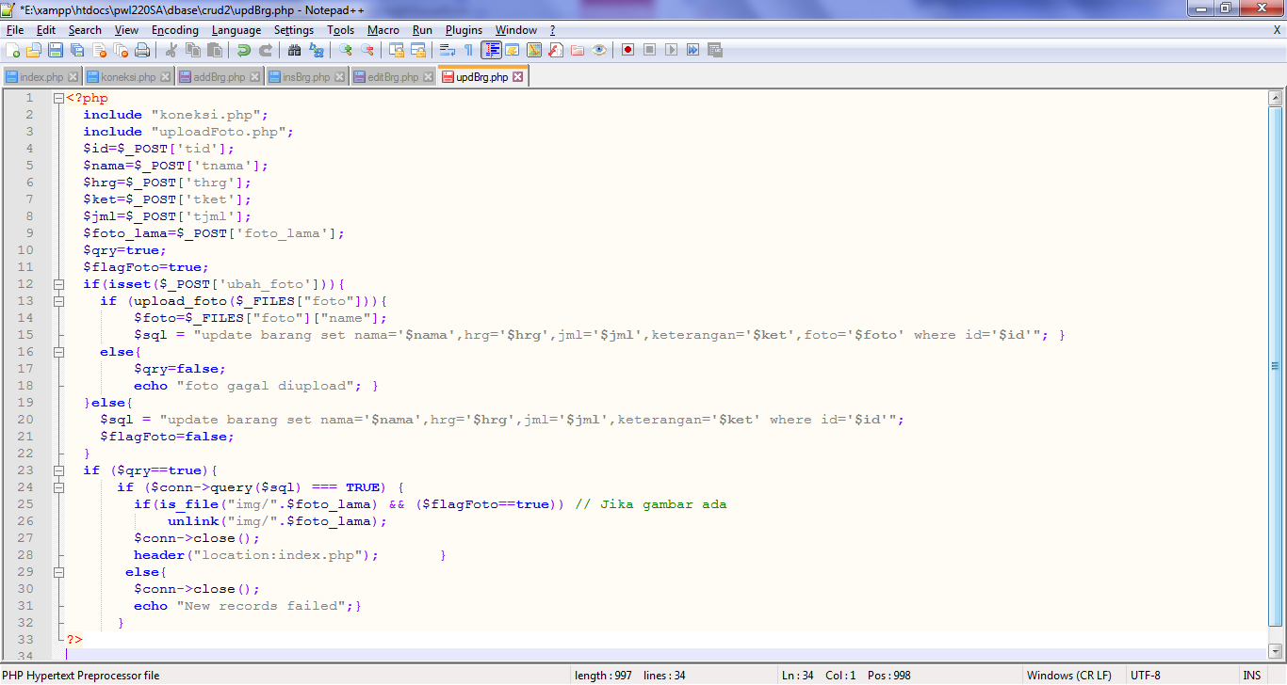
editBrg.php
updBrg.php

Slide 7
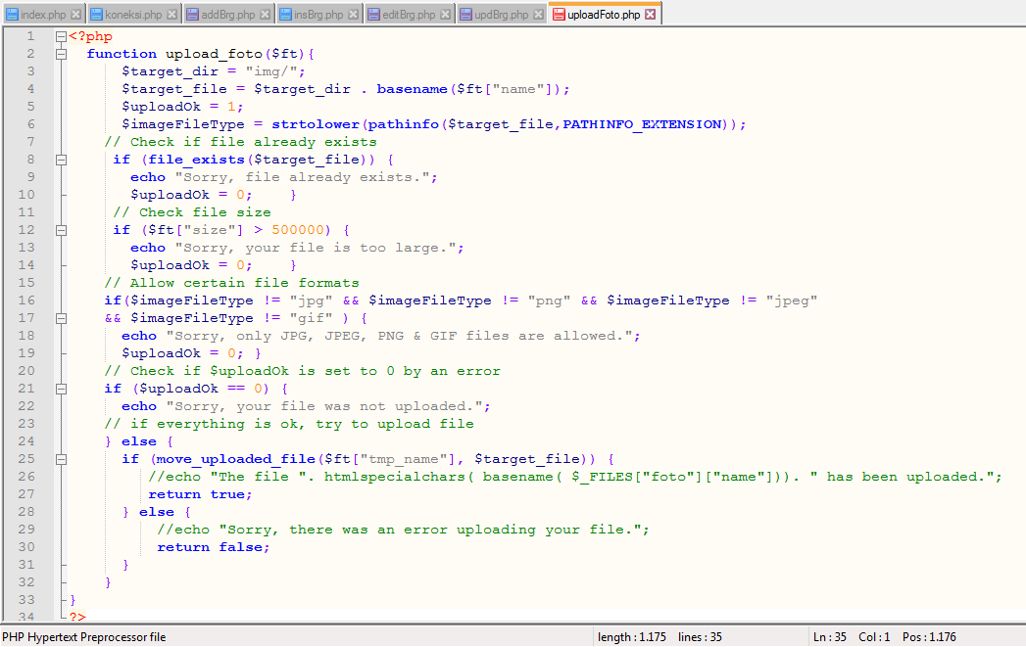
uploadFoto.php

Slide 8
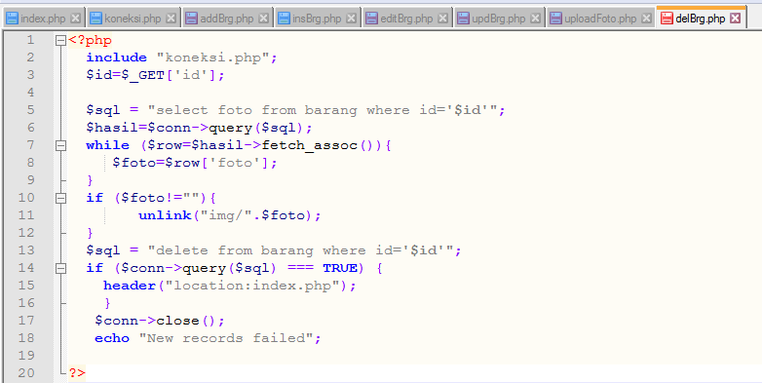
delBrg.php

Slide 9
E:\xampp\htdocs\pwl220SA\dbase\crud2.zip

